Slide 1

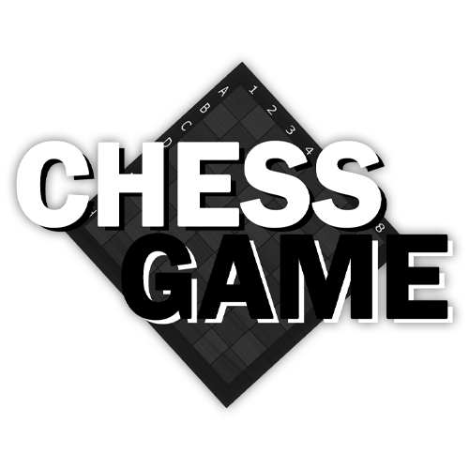
PRESENTING THE
APPLICATION
Develop By Carl Wyne S. Gallardo

Slide 2
sa
Introduce the Game
Showcase each Forms
Explain Functionalities
Application Demo

Slide 3
sa
Introducing the Game

Slide 4
Original Chess Game
C# programming language
Developed through Windows Form
Design Consistency
Background Music & Sound Efx
APPLICATION

Slide 5
sa
Showcase each Forms

Slide 6
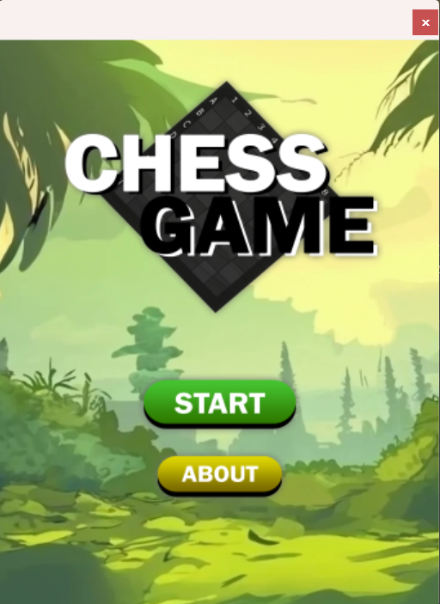
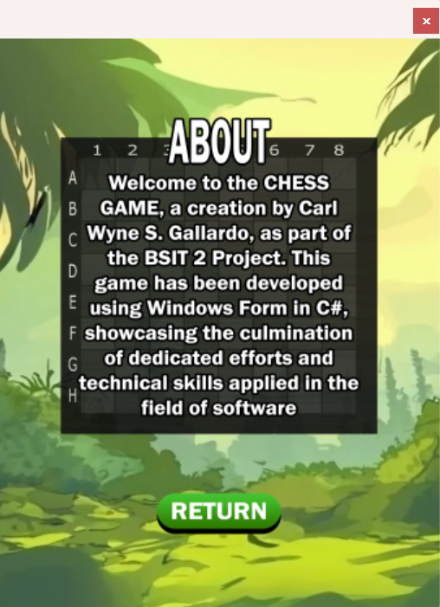
HOME SECTION
ABOUT SECTION

Slide 7
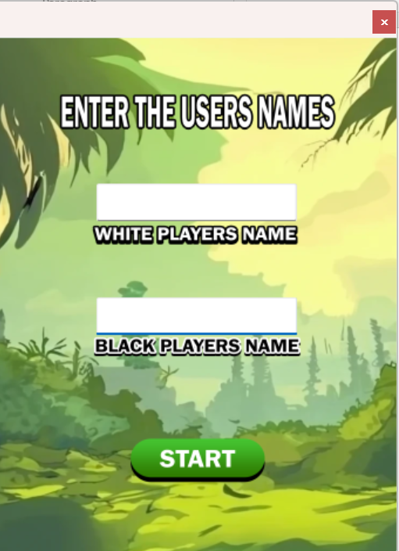
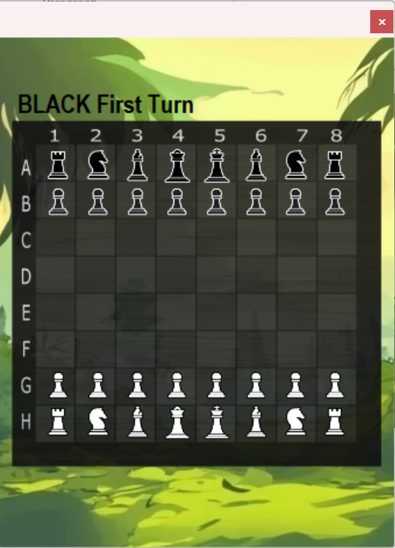
NAME INPUT SECTION
PLAYING SECTION

Slide 8
sa
Explain Functionalities

Slide 9
HOME SECTION
Background Music
Navigates to Name Input Section
Navigates to About Section

Slide 10
ABOUT SECTION
Continues Background Music
Info About the Game
Navigates to Home Section

Slide 11
NAME INPUT SECTION
Continues Background Music
User can Input Player Names
Navigates to Playing Section(If the Usernames are already provided)

Slide 12
Playing Section
Chess Game Functionality
Stops the Background Music (to avoid destruction)
Sound Effects every of movement
Tells Which player is Moving
Highlights the available Movements

Slide 13
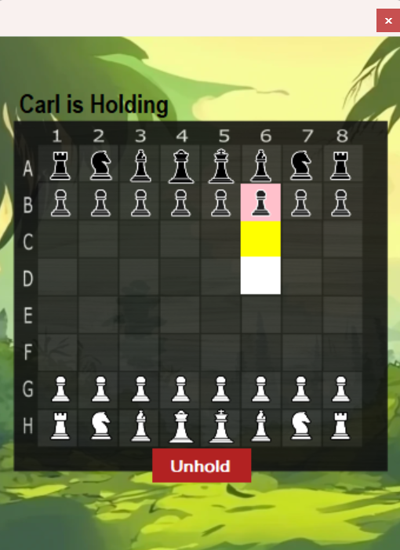
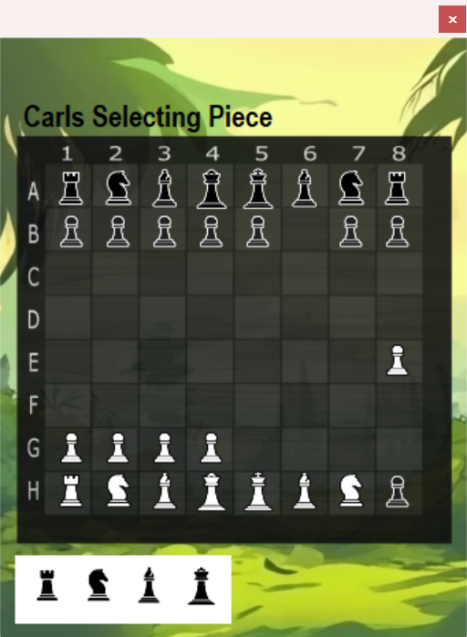
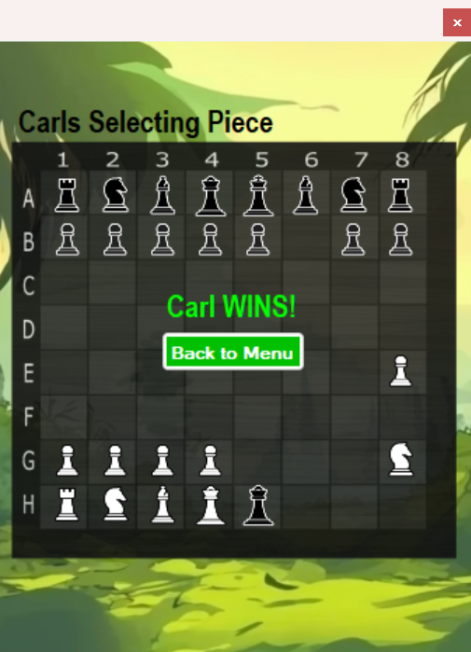
When Holding a Piece
(you can unhold)
Pawn Promotion
Celebrates the winner with sound effects.
(And Navigates to Home Section)

Slide 14
sa
Application Demo

Slide 15
sa
That’s all, Thank you!

